Slide 1
BRAND EXAMPLES
Notes:
Agenda
Target audiences and how to reach them
General awareness activities
RI’s role

Slide 2
WHICH ONES GOT IT RIGHT?
WHICH ONES NEED HELP?

Slide 3

EXAMPLE 1

Slide 4

EXAMPLE 2

Slide 5
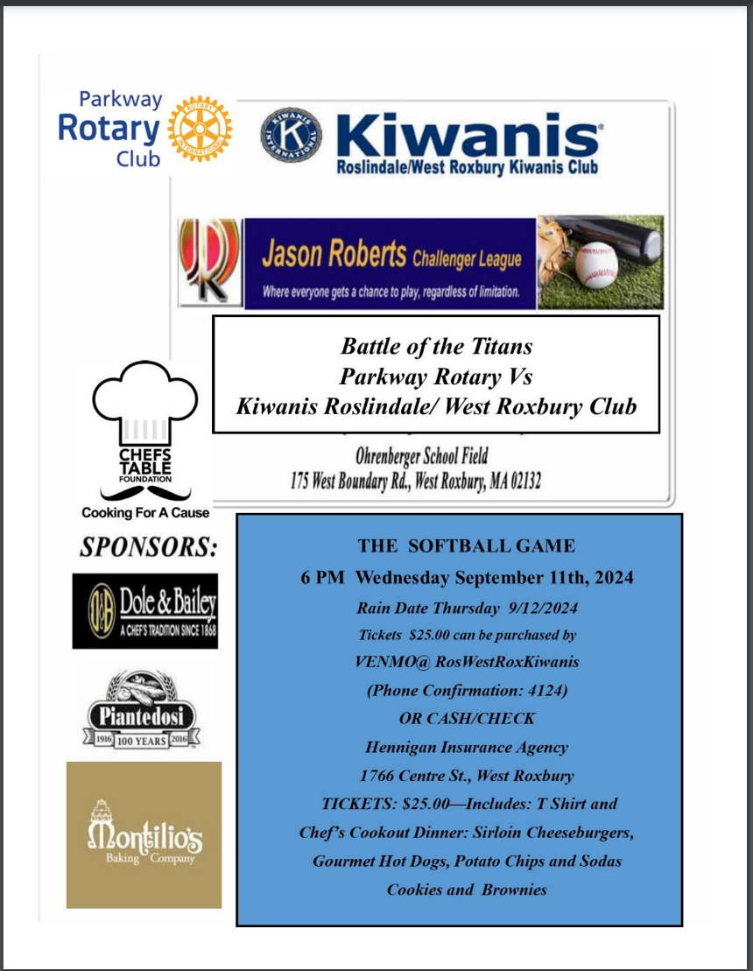
EXAMPLE 3

Slide 6

EXAMPLE 4

Slide 7

EXAMPLE 5

Slide 8

EXAMPLE 6

Slide 9

EXAMPLE 7

Slide 10

EXAMPLE 8

Slide 11

EXAMPLE 9

Slide 12

EXAMPLE 10

Slide 13

EXAMPLE 11

Slide 14

EXAMPLE 12

Slide 15

EXAMPLE 13

Slide 16
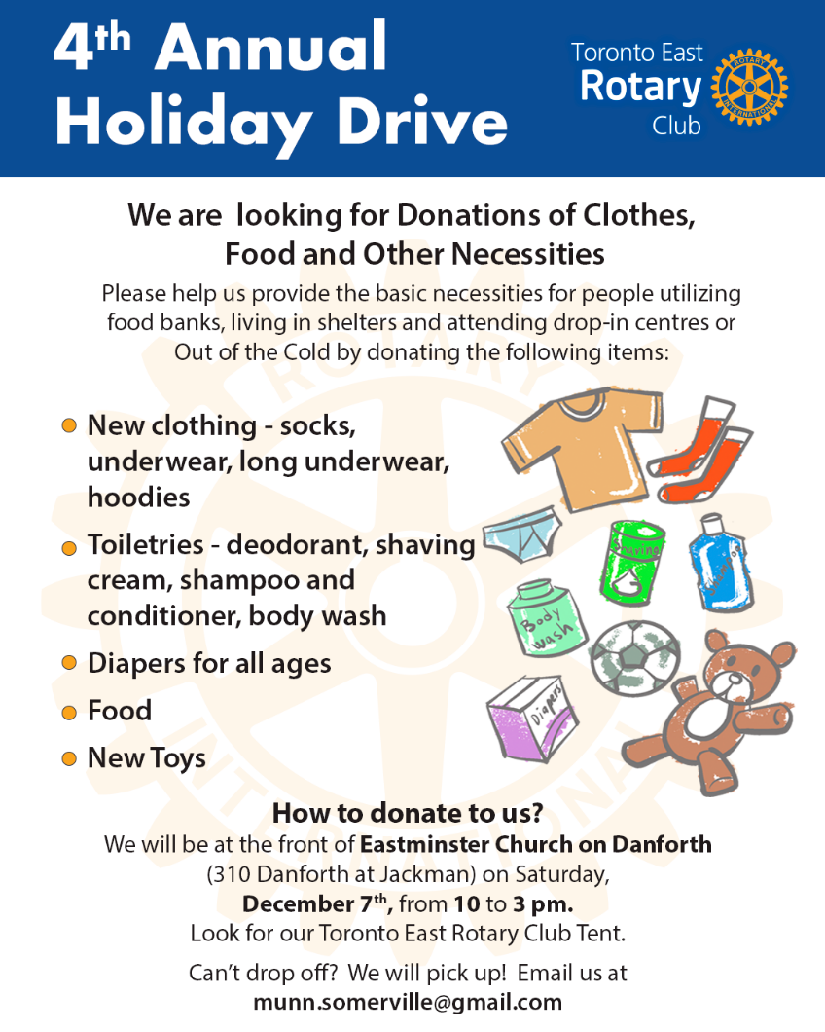
EXAMPLE 13

Slide 17

EXAMPLE 14

Slide 18
CALL TO ACTION
Work with your clubs to:
Understand the primary brand elements, particularly logos and naming
Feel comfortable using the Brand Center and templates
Take the short, basic brand courses in Learning Center
Attend public image webinars, learning opportunities outside of Learning Center
Share their promotional materials with you for review before promotion/production
Notes:
In conclusion, keep these points in mind as you head into the new year as District Public Image charis

